Slide 1
Week 11
Review
Data Types and CREATE TABLE
Constraints
Transactions
Assignment

Slide 2
REVIEW
Week 1: Database (Definition – History) – Table – Network Components – Restore databases
Week 2: Data types (5) – NULL values – PRINT – USE – SELECT … FROM … WHERE …ORDER BY … - OR – AND – NOT
Week 3: GETDATE(), DATEPART, DATEADD, DATEDIFF, CAST, CONVERT, Query standards, IS NULL, IN, BETWEEN, LIKE, AS
Week 4: JOIN – Inner JOIN – FULL OUTER JOIN – LEFT and RIGHT JOINS
Week 5: Sub-Query – DISTINCT – COUNT – MIN – MAX – AVG – SUM – GROUP BY
WEEK 6 – DECLARE – CREATE TABLE – DROP TABLE – IDENTITY - Insert into … VALUES – DELETE – TRUNCATE – SELECT * INTO – TOP – UPDATE
Week 7 Mid-term
Week 8: Smart Database Design (1NF) – Primary Key – Advance UPDATE – Begin Transaction … ROLLBACK
Week 9: Smart Database Design (2NF, 3NF) - functional dependency – Foreign Key

Slide 3
Data Types
Each column in a table has a data type.
The data type determines the type and amount of data you can store in a column.
Different types have different semantics and support different sets of operations.
https://docs.microsoft.com/en-us/sql/t-sql/data-types/data-types-transact-sql?view=sql-server-ver15

Slide 4
Character Types
CHAR(n)
VARCHAR(n)
TEXT
NCHAR(n)
NVARCHAR(n)
nTEXT
Fixed-length, up to 8K characters.
Variable length, up to 8K characters.
Variable length, up to 2GB characters.
Fixed length Unicode data, up to 4000 characters.
Variable length Unicode data, up to 2GB.
Variable length Unicode data, up to 2^30 –1 characters.

Slide 5
Binary (bit string) Types
BINARY(n) Fixed-length, up to 8K bytes
VARBINARY(n) Variable length, up to 8K bytes
IMAGE Variable length, up to 2GB bytes
BIT Supported values are 0,1, or NULL

Slide 6
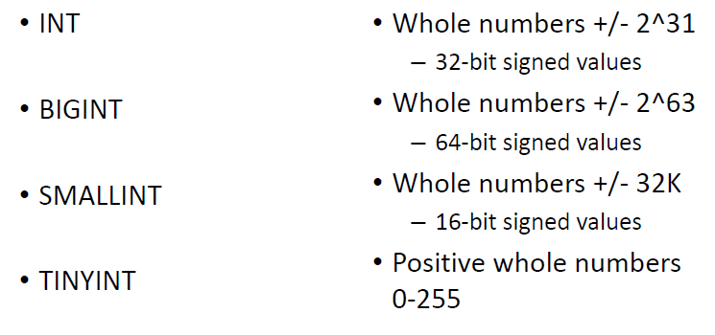
Exact Numeric Types

Slide 7
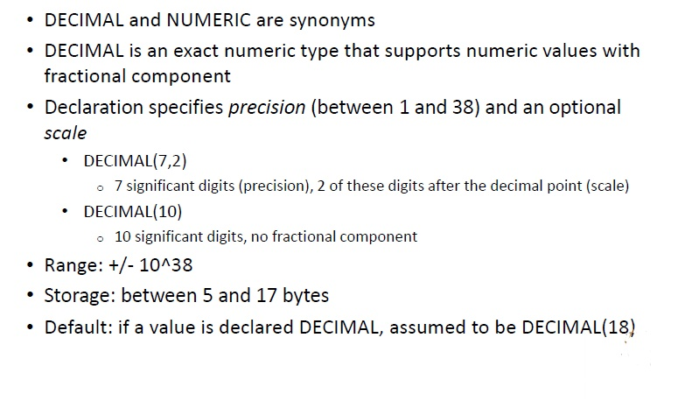
DECIMAL and NUMERIC types

Slide 8
Approximate Numeric Types
Approximate numeric types store floating-point values; specification uses scientific notation (mantissa and exponent)
Not all numbers can be represented exactly (mantissa is in base-2)
Should never be used for primary keys
REAL
Storage: 4 bytes
Range: -3.40E + 38 to -1.18E -38, 0 and 1.18E -38 to 3.40E + 38
FLOAT(n)
Value of n is between 1 and 53; number of bits used to store the mantissa of the number
Storage: 4 bytes if n <= 24; 8 bytes if n > 24
DOUBLE PRECISION
Synonym for FLOAT(53)

Slide 9
Date/Time types in SQL Server 2014
DATE
TIME
DATETIME
SMALLDATETIME
DATETIME2
DATETIMEOFFSET
DATE type:
Range: 1 January 0001 AD through 31 December 9999
•Date only, no time portion
•Default string format: ‘YYYY-MM-DD’
•Storage size: 3 bytes
•Default value: 1 January 1900

Slide 10
Other (vendor-specific) Types
MONEY
ROWVERSION
(formerly known as TIMESTAMP)
TIMESTAMP is still supported as a row version type
Money amounts to the trillions with 4 decimal places accuracy
A database-wide unique row number

Slide 11
IF EXISTS
DROP TABLE IF EXITS tablename
(SQL 2016)
IF OBJECT_ID (‘tablename', 'U') IS NOT NULL DROP TABLE tablename;
(Older versions)
User Define

